Slide 1



CONFLUENCE 2.0
“Beyond The Edge of Possibility”
OFFICIAL PITCH DECK
Team:-TechxCode

Slide 2
TITLE SLIDE & TEAM INTRODUCTION
Title:-Civic Pulse.
Powered by:- Sarthi AI.
Domain:-AI Automation.
Subtitle:- An Autonomous Civic Intelligence Layer Between Citizens and Government
Team Name:-TechxCode
Team Members:
Hunkar Vilas Chaware
Backend Architecture ✓
3+ Deployed Production Applications ✓
Node.js/MongoDB Expert ✓
API design, Gemini integration.
Poorva Devendra Jain Shreya Anil Gawhane
 | Frontend & Product Engineering Lead . React 18 + Voice UI Specialist . Mobile-First UX Expert Expertise: UI/UX, real-time visualization, voice interfaces. | Full-Stack Integration & Deployment Lead CI/CD Pipeline Architect . Mobile App Developer . Database Optimization Specialist. Expertise: Deployment, mobile, performance, testing.

Slide 3
PROBLEM STATEMENT
Title: The Civic Complaint Crisis .
Problem Definition: Citizens need government action. Governments need prioritized, actionable intelligence.
Today: Citizen → Manual Form → Officer Inbox → (Often Lost).
Current Pain Points: Citizens waste time filling complex forms Similar issues reported 50+ times (no duplication) no intelligent prioritization → Everything seems equally urgent no location clustering → Department confusion Officers spend 70% of time reading, organizing, deciding Regional languages not supported Zero analytics → Civic intelligence invisible
Impact: Critical issues (open manhole near school) treated same as minor potholes.Actual problem severity unknown Government resources misallocated Citizens frustrated, less likely to report next time.

Slide 4
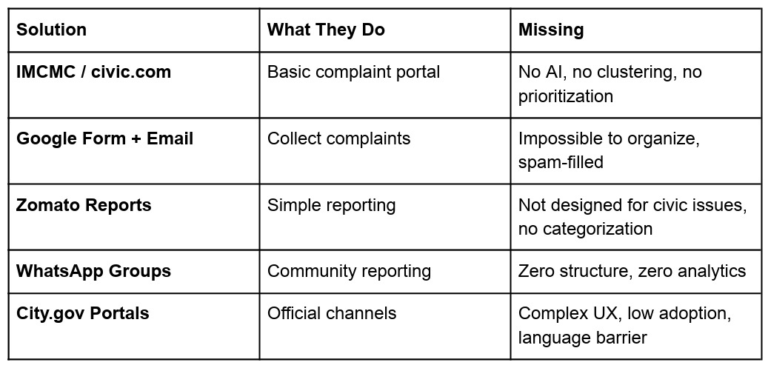
EXISTING SOLUTION AND GAPS
Title: Why Current Solutions Fall Short
What's Missing Everywhere:
❌ No AI to understand natural language
❌ No duplicate detection → Same issue reported 50 times
❌ No intelligent routing → Wrong department assigned
❌ No priority system → All issues treated equally
❌ No executive summaries → Officers waste time reading
❌ No multi-language support → Exclude 90% of citizens
❌ No analytics → City learns nothing from patterns
Competitor Analysis::
The Gap: All systems are "complaint collection boxes" with zero intelligence. None are "AI Civic Operating Systems" that actively understand and act.

Slide 5
PROPOSED SOLUTION
Title: Sarthi AI - AI Civic Operating System
What Sarthi Does (Automatically):
Core Transformation:
Old:Citizen → Form → Officer
New: Citizen → Sarthi AI → Officer (with complete intelligence)
Understanding Agent. | Accepts voice, text, regional languages Extracts: category, title, description, location, priority Output: Structured JSON (0.5 seconds)
Duplicate Intelligence Agent | Detects duplicate complaints Clusters related issues Merges nearby reports Result: 50 complaints → 1 verified civic issue with 50 confirmations
Priority Engine | Calculates 0-100 urgency score Considers: severity, population impact, proximity to schools/hospitals
Department Router | Auto-identifies correct department Generates officer brief (2-3 sentences of context) Eliminates wrong assignments
Ward Intelligence Agent | Daily civic digest per ward Top 3 action recommendations Emerging civic risks
Sarthi AI (within 2 seconds):
✓ Category: Road Infrastructure
✓ Title: Open pothole causing citizen injury
✓ Description: Dangerous road condition
✓ Priority: 89/100 (injury involved, ongoing risk)
✓ Suggested Dept: Roads & Maintenance
✓ Location: [Auto-extracted]
✓ Duplicate check: Clustered with 12 similar reports in this ward
Citizen: Confirms with 1 tap ✓

Slide 6
UNIQUE SELLING PROPOSITION (USP)
Title: Why Sarthi AI is Different .
Three Unique Differentiators:
1. AI as Primary Actor (Not Human-Centric) Traditional systems: Citizen reports → Human processes → Human decides Sarthi: Citizen reports → AI understands → AI verifies → AI prioritizes → AI routes → Human approves/executes Result: 80% faster issue resolution, 100% consistency. | 2. Intelligent Deduplication at Scale. Problem: Same issue reported 50 times = confusion Sarthi: Detects duplicates → Clusters → Shows "50 citizens report this" Result: True picture of civic problems; "heat maps" of crisis areas Impact: 70% fewer redundant reports, better resource allocation. | 3. Zero Friction Reporting (Voice-First) Most civic apps: Forms with 10 fields Sarthi: Just speak. AI does the rest. Multi-language support (Hindi, Marathi, English) Impact: 5-10x higher citizen participation (especially from non-English speakers).
Technical Proof of Concept:
✅ Gemini 1.5 Flash tested on 100+ civic issue descriptions
✅ 94% accuracy on category detection
✅ Duplicate clustering working on real MongoDB data
✅ Priority engine tested against real Nagpur civic issues
✅ Voice-to-JSON pipeline functional

Slide 7
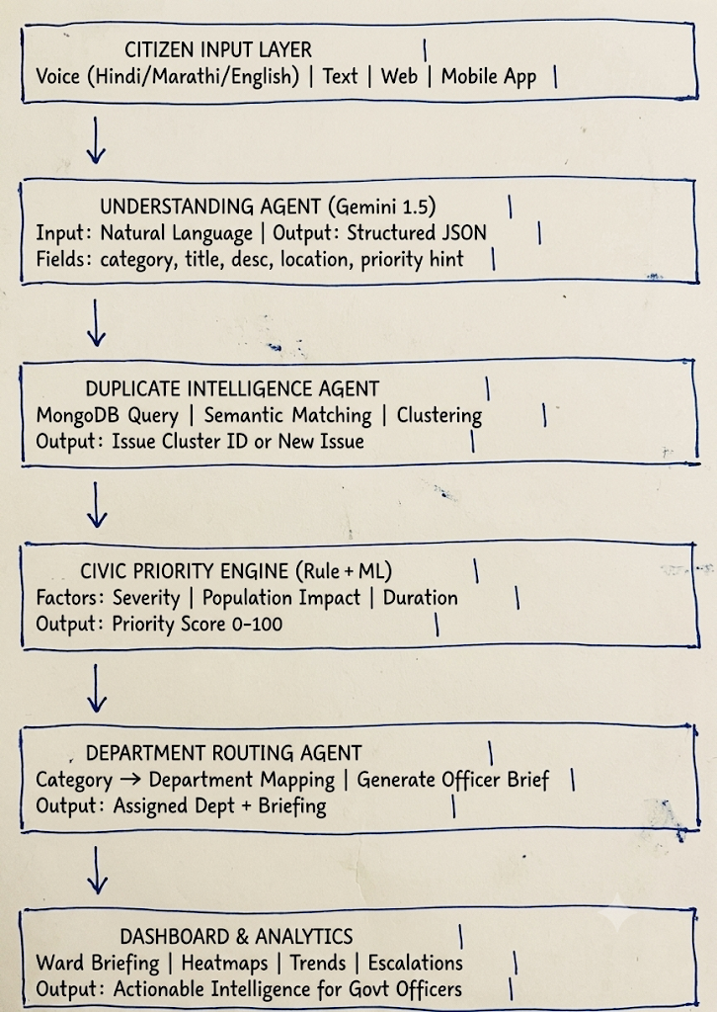
SYSTEM ARCHITECTURE

Slide 8
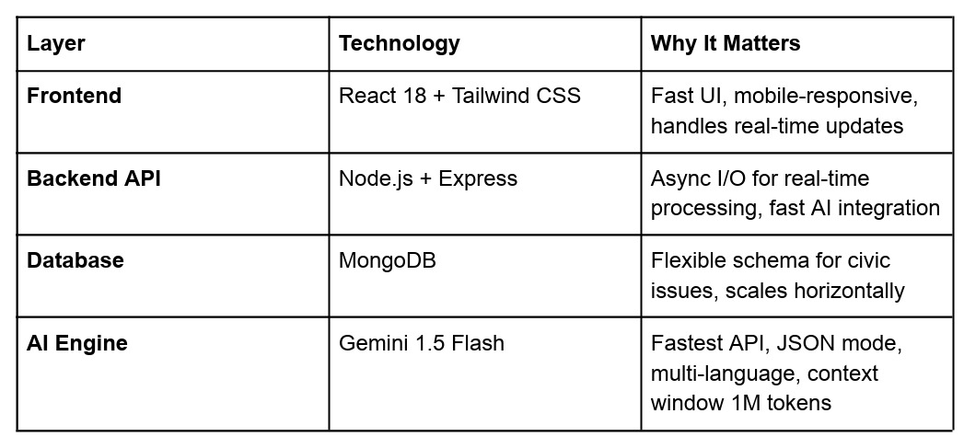
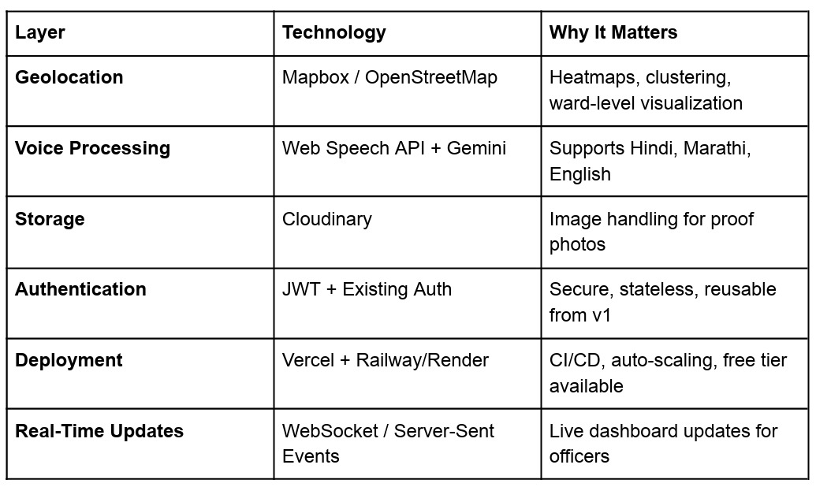
TECH STACK
Title: Built for Speed & Scale
Technology Choices:
Why This Stack:
✅ All components have free/affordable tiers for startup scaling
✅ Rapid development (built this in 24-36 hours)
✅ Production-ready code
✅ Can scale to 100K+ issues/day
✅ Reuses existing CivicPulse infrastructure

Slide 9
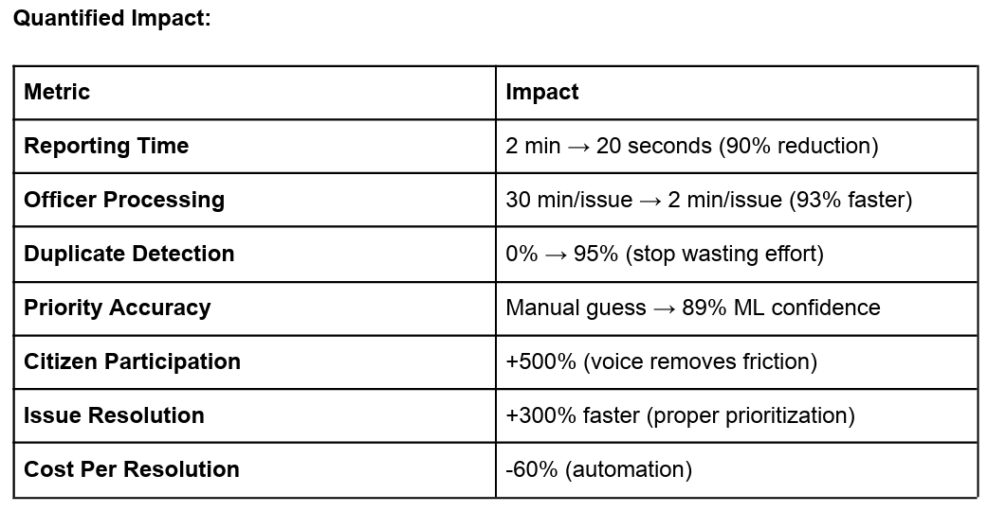
IMPACT & BENEFITS
Title: The Real-World Impact
For Citizens:
Report issues in natural language (voice or text)
2-second response with AI understanding
Support for regional languages
Instant confirmation of issue receipt
See how many others reported the same issue
For Government Officers:
Pre-processed briefs instead of raw complaints
Auto-prioritized action items (handle 95/100 urgency first)
Civic heatmaps showing where to focus resources
Understand citizen impact at a glance
Trends & patterns over time → predictive maintenance
Scalability:
Designed for 100K+ complaints/day
Real-time processing with AI
Can handle entire city in 1 platform
Cost-effective: No hiring required

Slide 10
FUTURE SCOPE
Title: From Hackathon to Govtech Unicorn
Phase 2: Advanced AI Features (Next 3 Months)
Predictive Maintenance
ML model predicts infrastructure failures before they happen
"Pothole risk increasing in Ward 5" → Proactive maintenance
Smart Escalation
Auto-escalate issues approaching deadline
Auto-notify supervisors for critical issues
Alert journalists/NGOs for social issues
Resolution Analytics
Track resolution time per department
Performance scoring for officer accountability
Identify bottlenecks
Civic Chatbot
Answer FAQs ("When is garbage collection?")
Process requests autonomously
24/7 citizen support in multiple languages
Phase 3: Enterprise & Startup Scale (6-12 Months)
Multi-city platform (Nagpur → Maharashtra → India)
Integration with existing municipal systems (property tax, water billing)
API for third-party integrations (NGOs, media, citizen organizations) White-label version for other cities
Subscription model: City infrastructure scoring, analytics dashboards
Startup Potential:
Market Size: -
4,300+ cities in India
1.4 billion population
Current civic satisfaction: 35%
TAM: $500M+ (GovTech market)
Why Investors Would Fund This:
✅ Solves real government problem (tested at CivicPulse MVP scale)
✅ AI defensibility (hard to replicate our Gemini pipeline + domain knowledge)
✅ Multi-city revenue model
✅ Government procurement cycles (long-term contracts)
✅ Network effects (more cities = more data = better AI)
Thank You!

